Slide 1


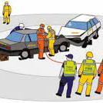
Status report of the factors of road accidents in NSW
Team Members:
Peter Kapsalis,
Jackson Sandler,
Anthony Tran,
Evgeniia Kozodeeva

Slide 2
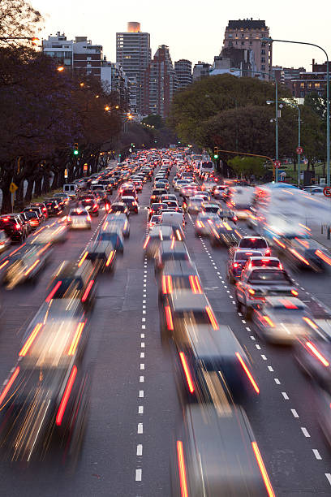
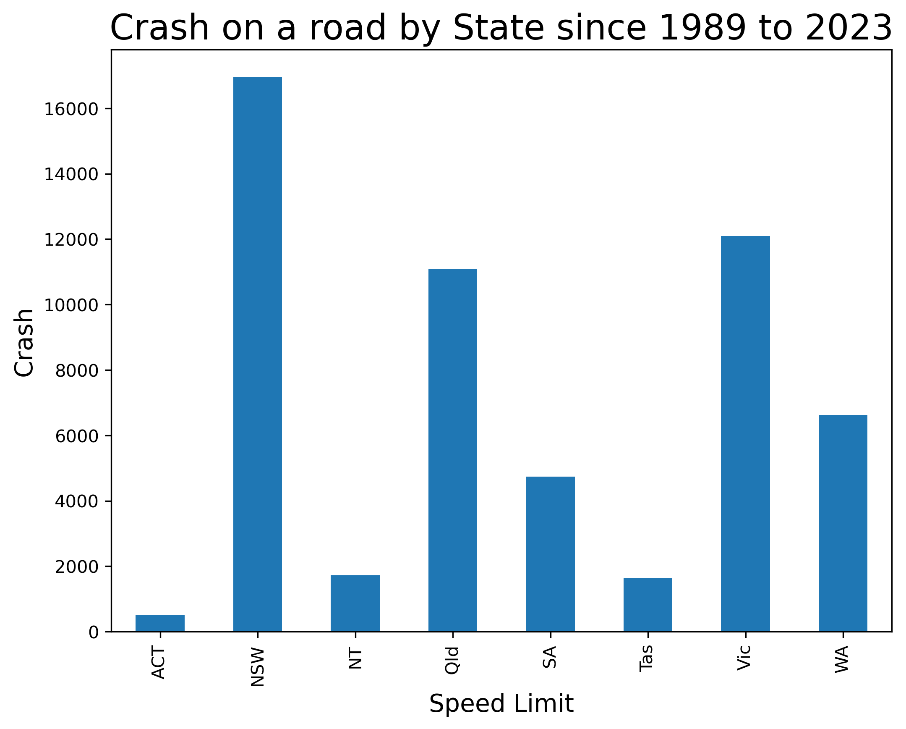
What is happening on the roads of Australia? Which state has the highest number of accidents?

Slide 3
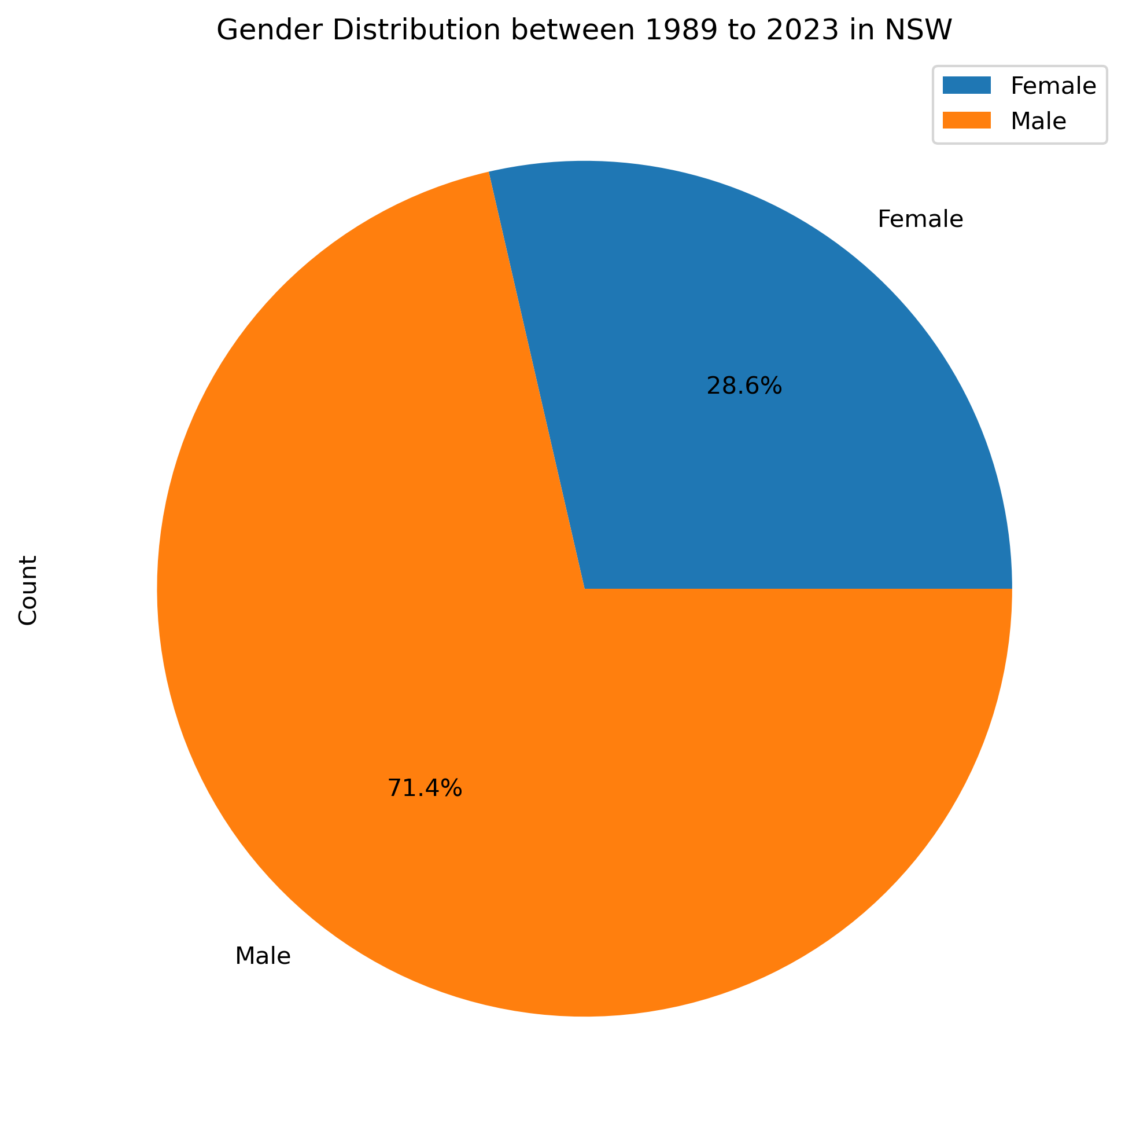

Demographic Factors Gender

Slide 4
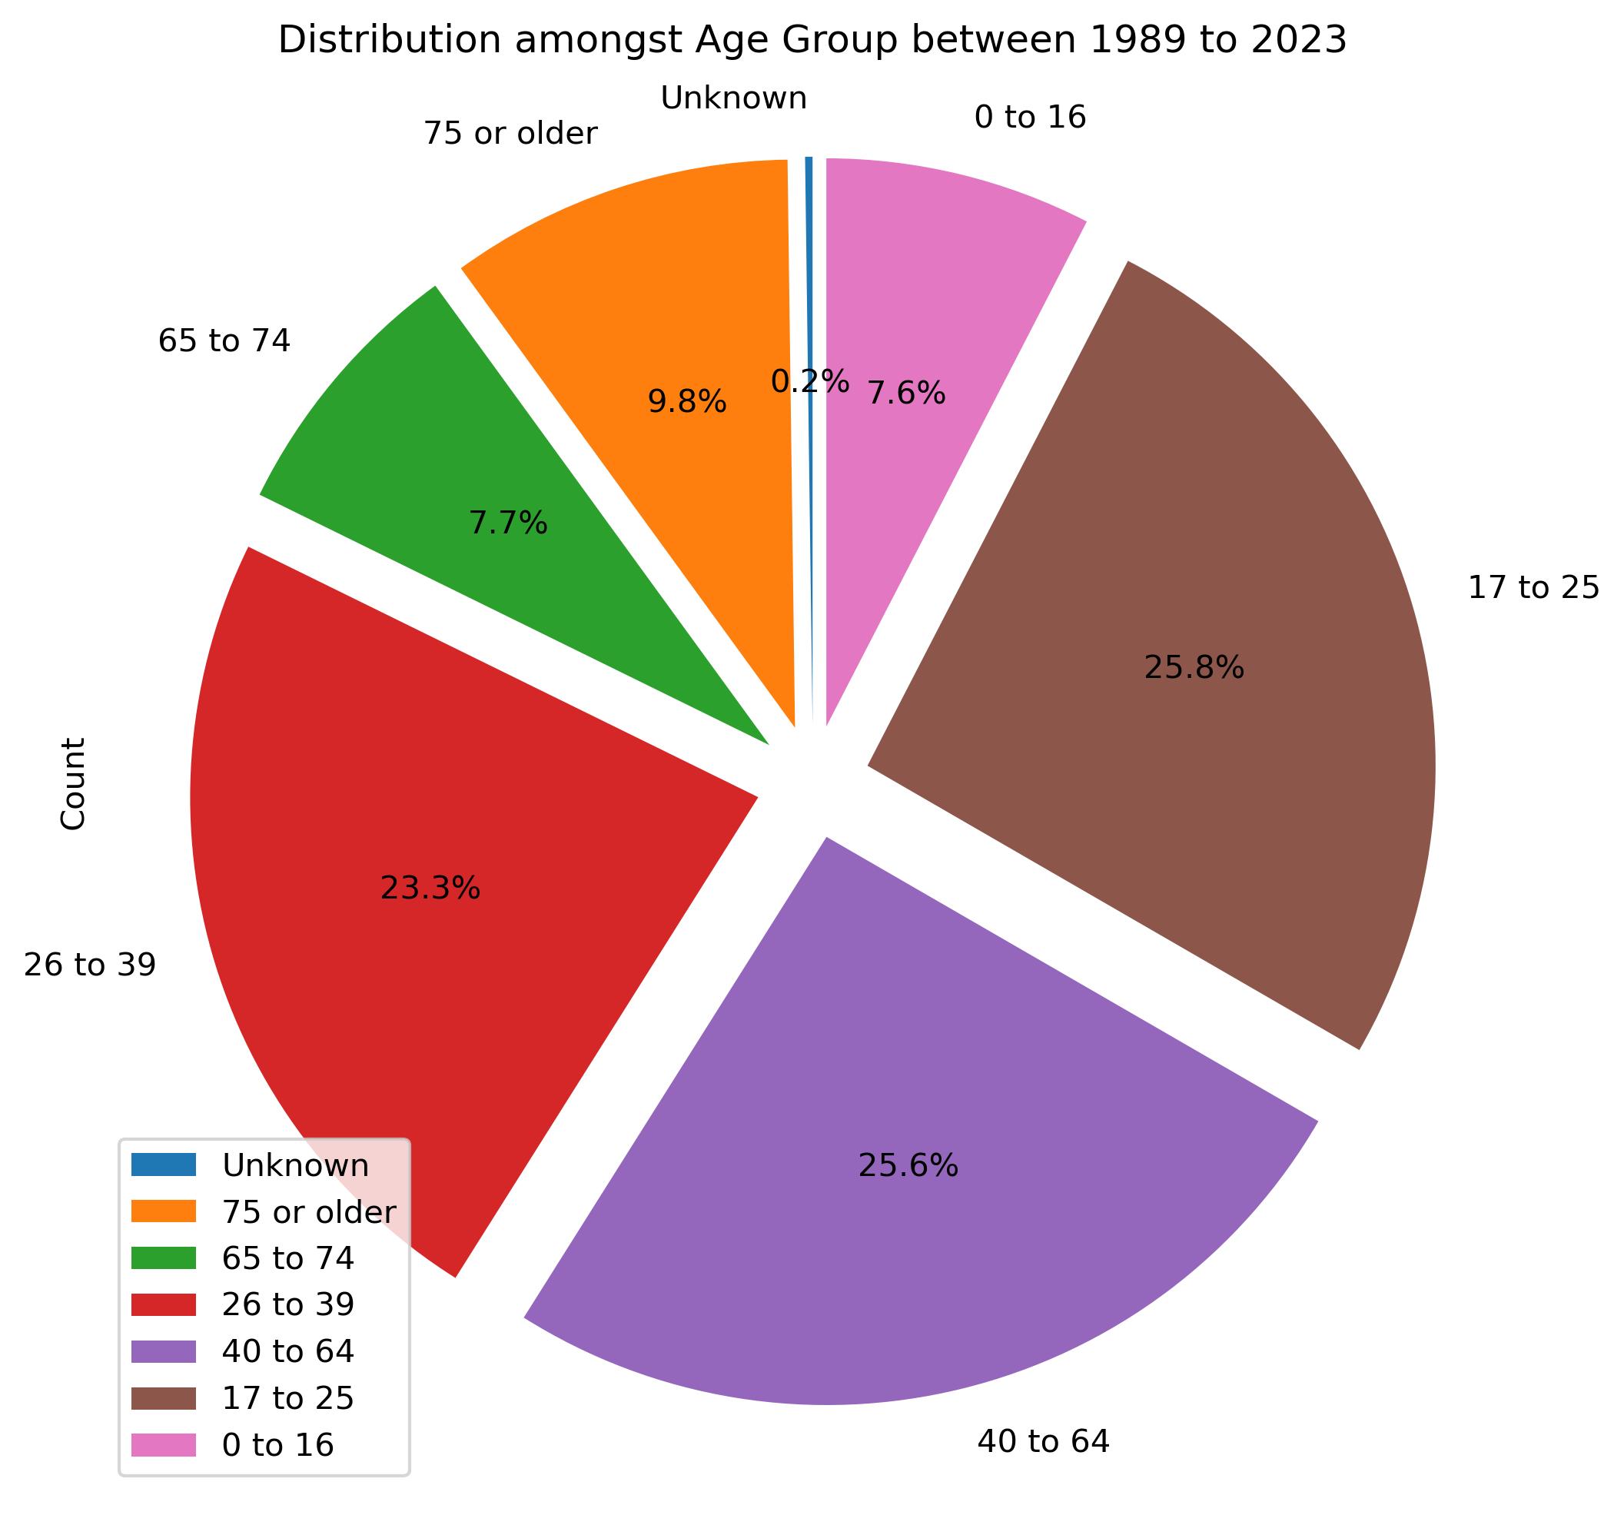
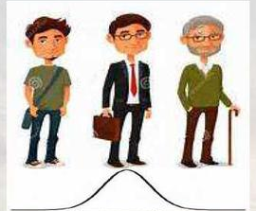
Demographic Factors Age

Slide 5
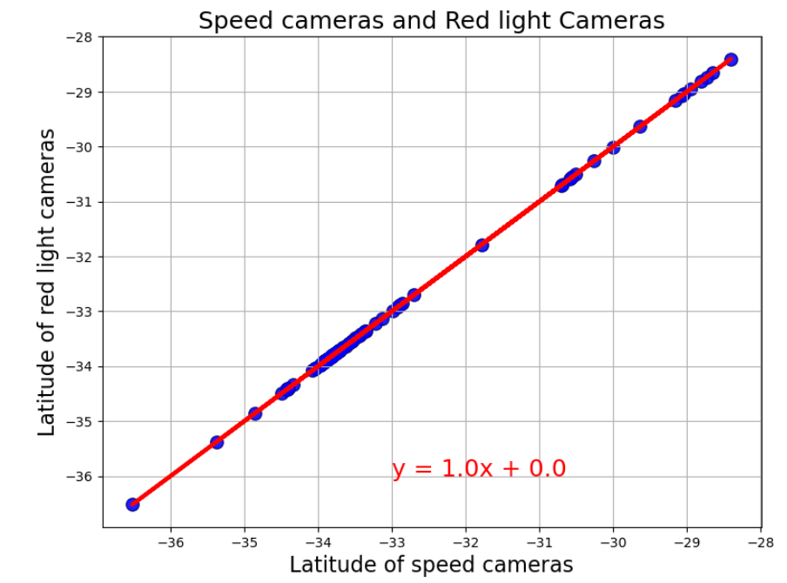
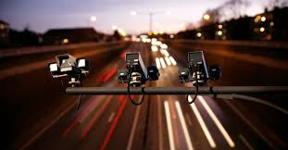
Traffic cameras
over 115 fixed cameras
over 103 red light cameras

Slide 6
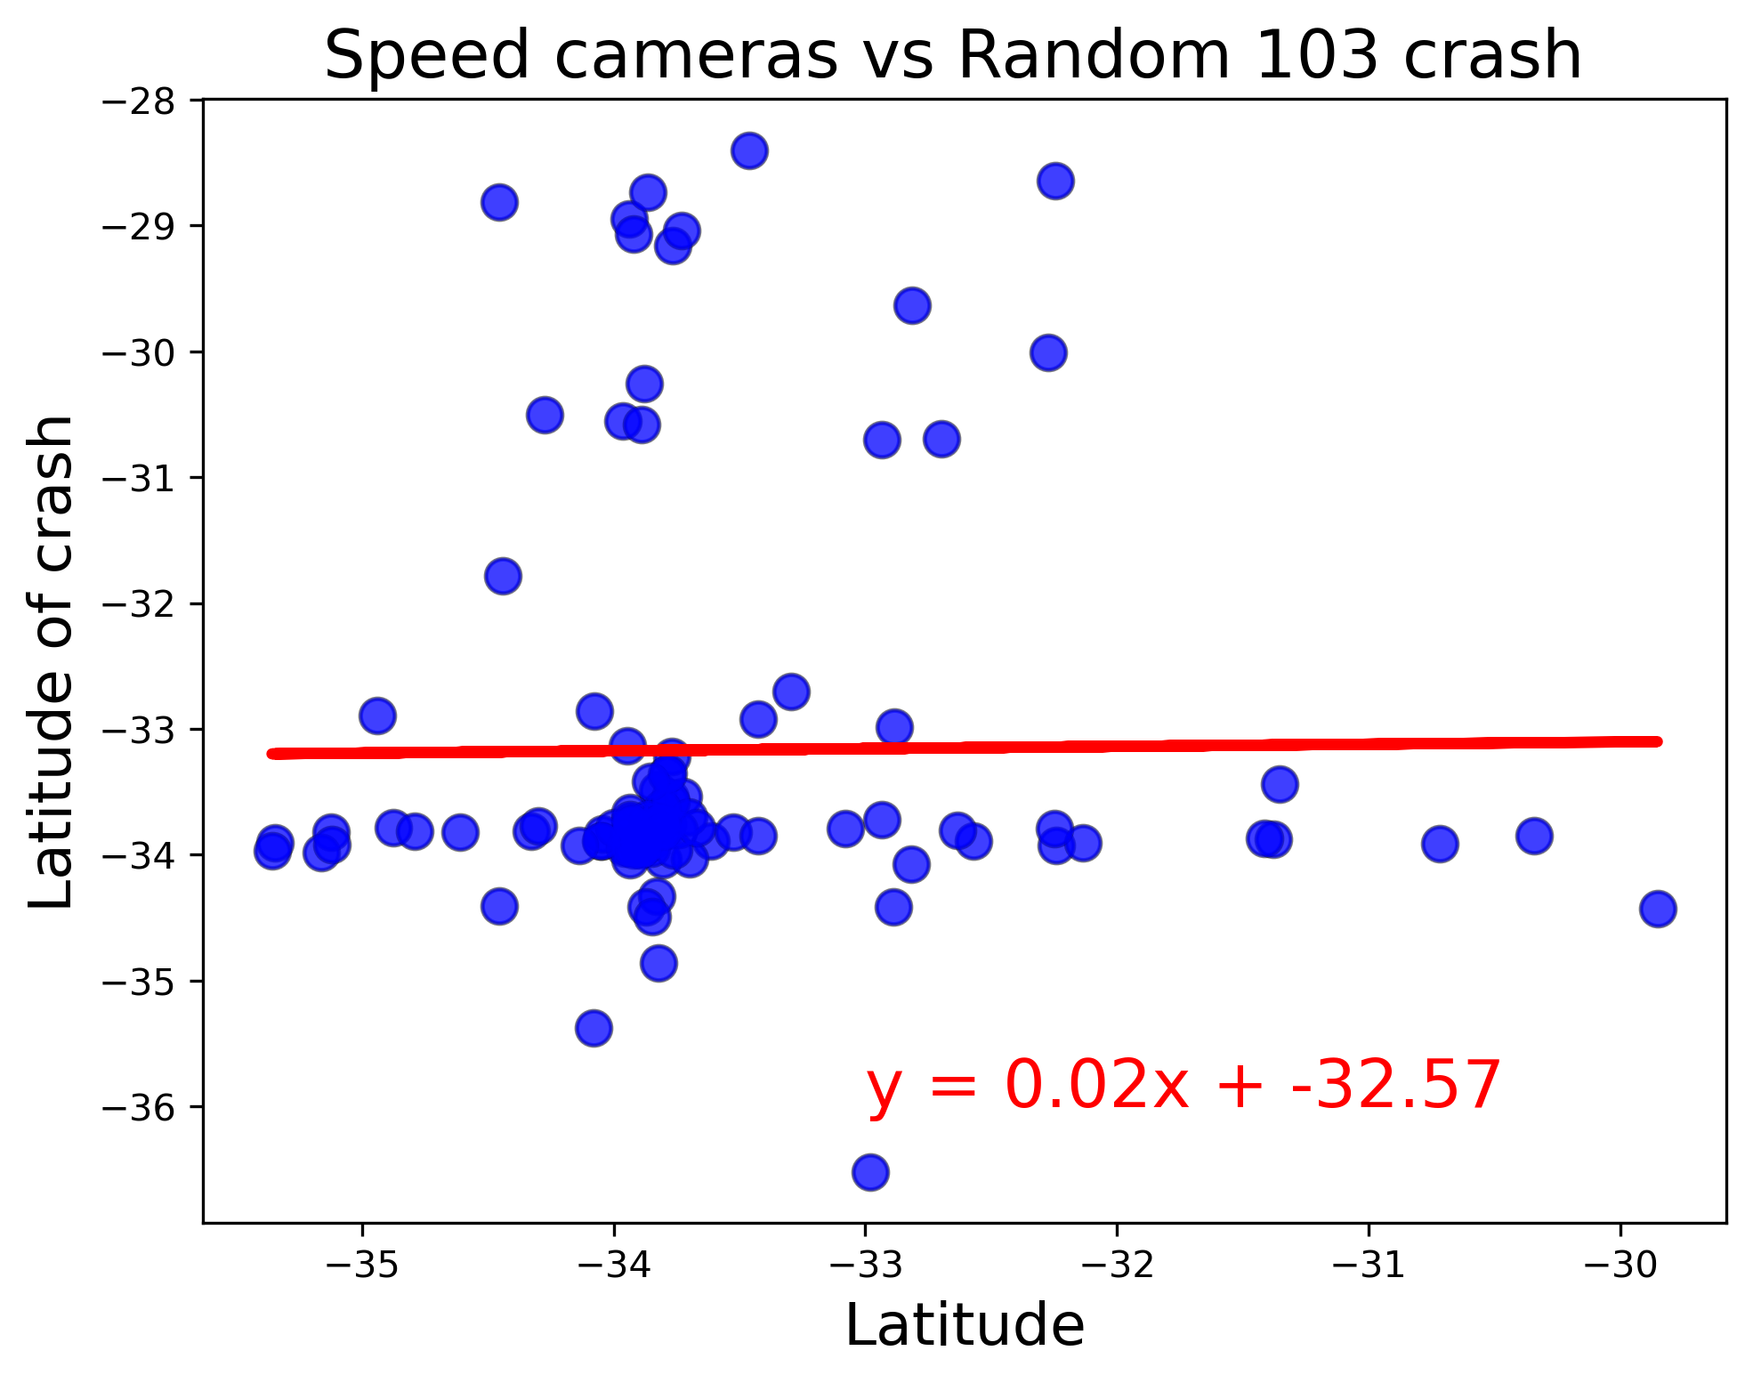
Regression between Cameras and crash
No linear relationship. It is mean, my random crashes were happed not near the speed camera. It is mean the speed camera help to avoid crash.

Slide 7
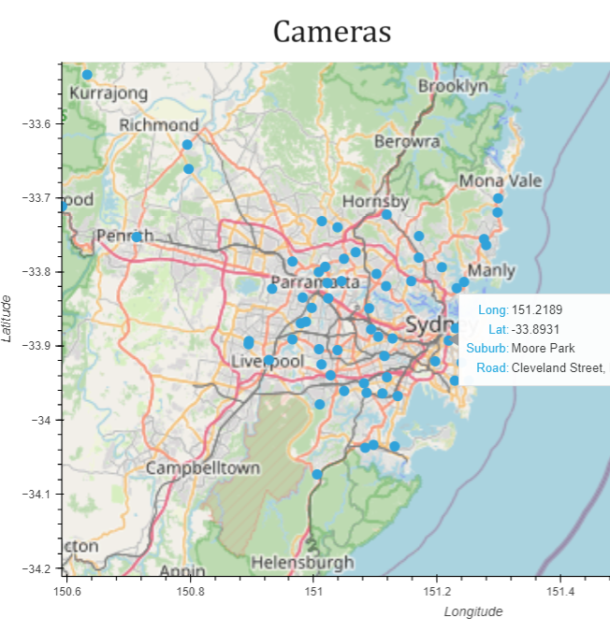
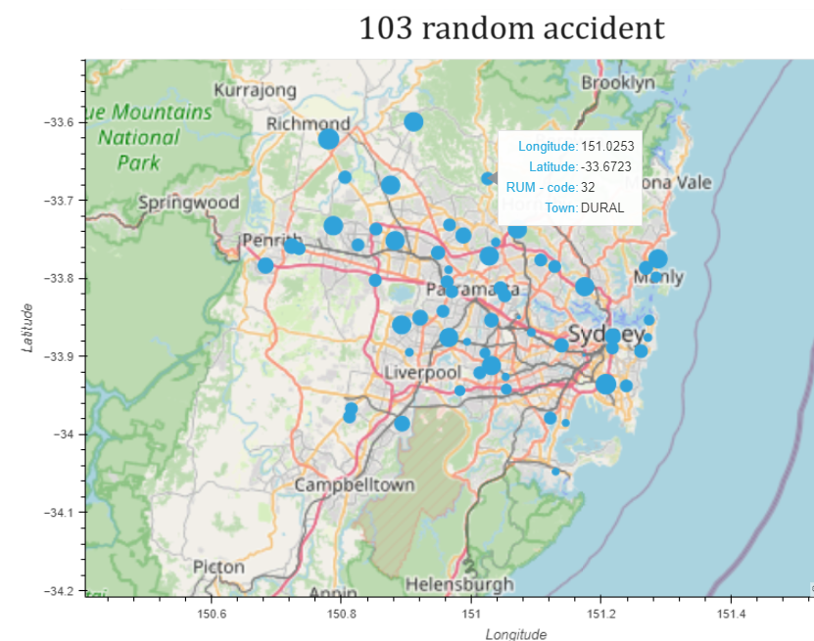
Geo mapping Crash and Cameras

